Slide 1
Machine Learning
Dr. Monali Mavani

Slide 2

Machine Learning
Disclaimer and Acknowledgement
The content for these slides has been obtained from books and various other source on the Internet
I here by acknowledge all the contributors for their material and inputs.
I have provided source information wherever necessary
I have added and modified the content to suit the requirements of the course

Slide 3
Session Content
Decision Tree

Slide 4
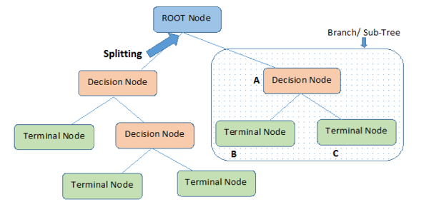
Decision Tree
A flow-chart-like tree structure
Internal node denotes a test on an attribute
Branch represents an outcome of the test
Leaf nodes represent class labels or class distribution
Decision tree generation consists of two phases
Tree construction
At start, all the training examples are at the root
Partition examples recursively based on selected attributes
Tree pruning
Identify and remove branches that reflect noise or outliers

Slide 5
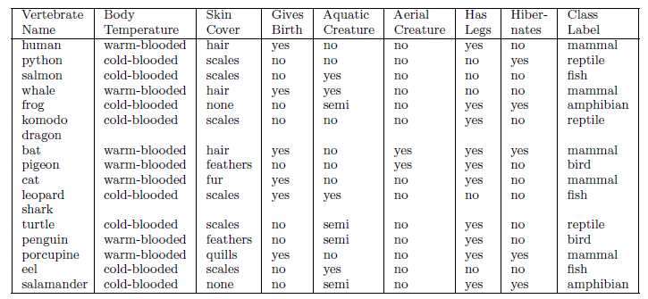
Decision Tree :Mammal Classification Problem

Slide 6
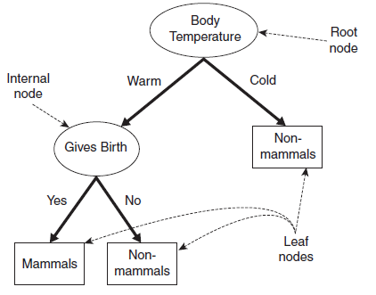
Decision Tree :Mammal Classification Problem
Recursive Partitioning: each node is divided into child nodes, and this process continues until a stopping criterion is met.
Homogeneity :homogeneous subgroups in each node, i.e samples within a node are as similar as possible regarding the target variable.
Top-Down Greedy Approach: each split is chosen to maximize information gain or minimize impurity at the current node.
May not always result in the globally optimal tree.

Slide 7
Decision Tree - example
At start, all the training examples are at the root
Partition examples recursively based on selected attributes
categorical
categorical
continuous
class
Splitting Attributes
Home Owner
Yes
No
NO
MarSt
Single, Divorced
Married
Income
NO
< 80K
> 80K
NO
YES
Training Data
Model: Decision Tree

Slide 8
Another Decision Tree same data
categorical
categorical
continuous
class
Single, Divorced
MarSt
Married
NO
Home Owner
Yes
No
NO
Income
< 80K
> 80K
NO
YES
There could be more than one tree that fits the same data!

Slide 9
Decision Tree Induction
Many Algorithms:
Hunt’s Algorithm (one of the earliest)
CART
ID3, C4.5
SLIQ,SPRINT

Slide 10
Hunt’s Algorithm
A decision tree is grown in a recursive fashion by partitioning the training records into successively purer subsets.
D_{t} = set of training records that are associated with node t
y = {y₁, y₂, . . . , y_{c}} class
labels
D_{t}
?
General Procedure:
If D_{t} is an empty set, then t is a leaf node labeled by the default class y_{t}
If D_{t} contains records that belong the same class y_{t}, then t is a leaf node labeled as y_{t}
If D_{t} contains records that belong to more than one class, use an attribute test to split the data into smaller subsets. Recursively apply the procedure to each subset

Slide 11
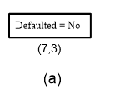
Decision tree construction example
The initial tree for the classification problem contains a single node with class label Defaulted = No ( most of the borrowers successfully repaid their loans)
If D_{t} contains records that belong to more than one class, use an attribute test to split the data into smaller subsets

Slide 12
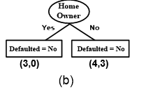
Contd..
If D_{t} contains records that belong to more than one class, use an attribute test to split the data into smaller subsets.
If D_{t} contains records that belong the same class y_{t}, then t is a leaf node labeled as y_{t}

Slide 13
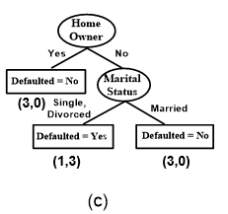
Contd..

Slide 14
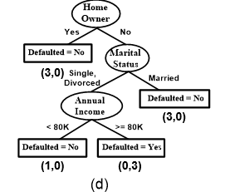
Contd..

Slide 15
Final Tree
Examples : 1,4,7
Examples : 2,6,9
Examples : 5,8,10
Examples : 3

Slide 16
Apply Model to Test Data
Start from the root of tree.
Test Data
Home Owner
Yes
No
NO
MarSt
Single, Divorced
Married
Income
NO
< 80K
> 80K
NO
YES

Slide 17
Apply Model to Test Data
Test Data
Home Owner
Yes
No
NO
MarSt
Single, Divorced
Married
Income
NO
< 80K
> 80K
NO
YES

Slide 18
Apply Model to Test Data
Test Data
Home Owner
Yes
No
NO
MarSt
Single, Divorced
Married
Income
NO
< 80K
> 80K
NO
YES

Slide 19
Apply Model to Test Data
Test Data
Home Owner
Yes
No
NO
MarSt
Single, Divorced
Married
Income
NO
< 80K
> 80K
NO
YES

Slide 20
Apply Model to Test Data
Test Data
Home Owner
Yes
No
NO
MarSt
Single, Divorced
Married
Income
NO
< 80K
> 80K
NO
YES

Slide 21
Apply Model to Test Data
Test Data
Home Owner
Yes
No
NO
MarSt
Single, Divorced
Married
Assign Defaulted to “No”
Income
NO
< 80K
> 80K
NO
YES

Slide 22
Design Issues of Decision Tree Induction
How should training records be split?
Method for expressing test condition
depending on attribute types
Binary, Nominal, Ordinal, Continuous
Measure for evaluating the goodness of a test condition
How should the splitting procedure stop?
Stop splitting if all the records belong to the same class or have identical attribute values
Early termination

Slide 23
Test Condition for Nominal Attributes
Multi-way split:
Use as many partitions as distinct values.
Binary split:
Divides values into two subsets

Slide 24
Test Condition for Ordinal Attributes
Multi-way split:
Use as many partitions as distinct values.
Binary split:
Divides values into two subsets
Preserve order property among attribute values
This grouping violates order property

Slide 25
Test Condition for Continuous Attributes
Binary Decision : consider all possible splits and finds the best cut can be more compute intensive
Discretization : to form an ordinal
categorical attribute

Slide 26
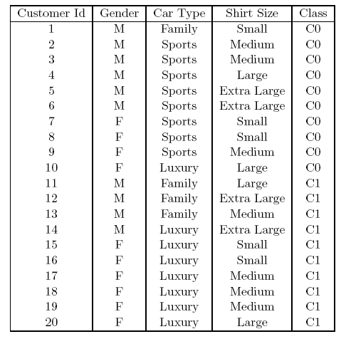
How to determine the Best Split
Before Splitting: 10 records of class 0, 10 records of class 1
Which test condition is the best?

Slide 27
How to determine the Best Split
Impurity is a measure of homogeneity of the labels at the node at hand
Greedy approach:
Nodes with purer class distribution are preferred
Need a measure of node impurity:
High degree of impurity/ High Uncertainty
Relating it to information theory:
Low information content e.g It rained heavily in Shillong yesterday
Low degree of impurity / Low Uncertainty
Relating it to information theory:
High information content e.g There was a heavy rainfall in Rajasthan last night.
Introduction to Data Mining, 2nd Edition

Slide 28
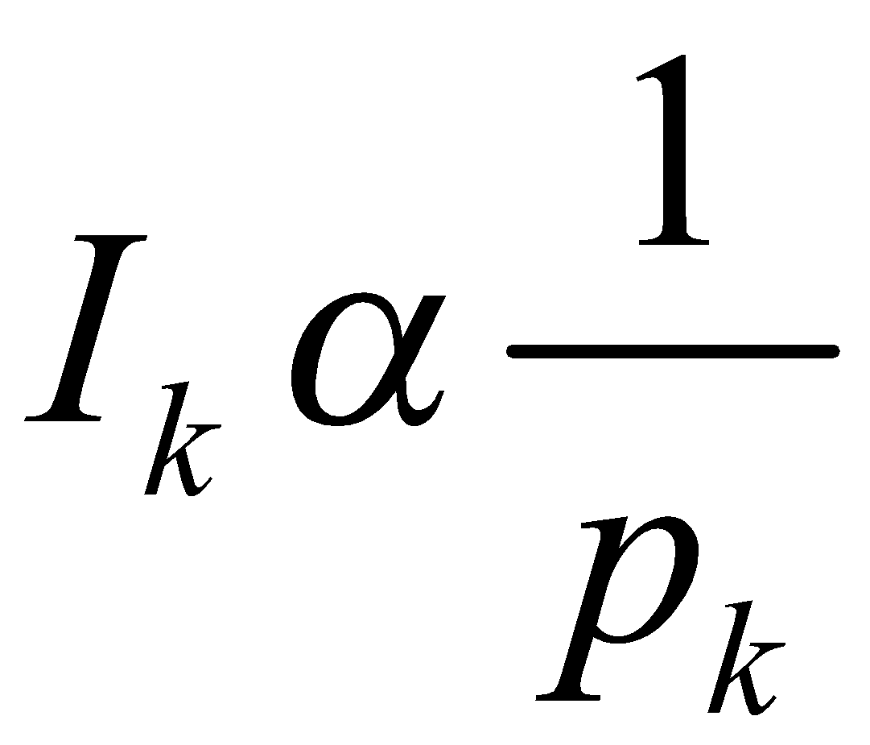
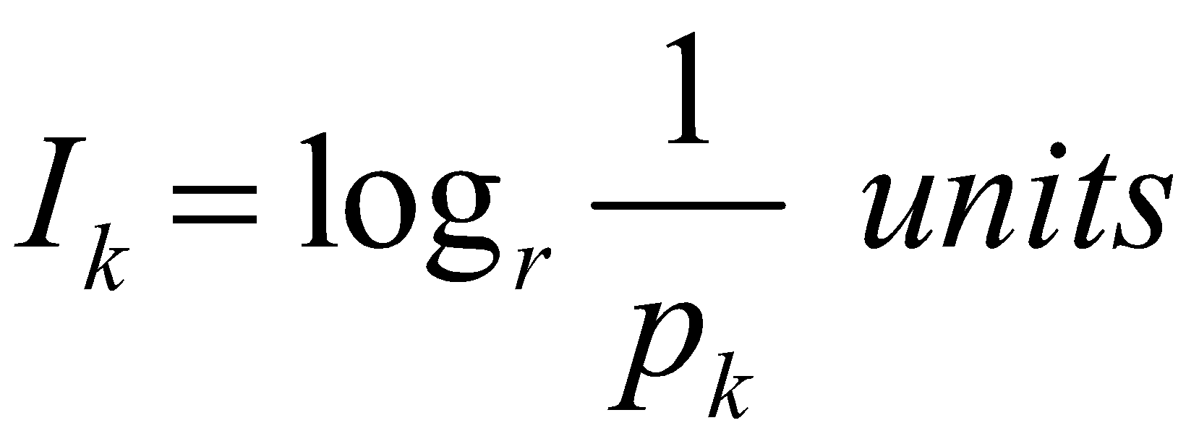
Measure of Information
The amount of information (surprise element) conveyed by a message is inversely proportional to its probability of occurrence. That is
The mathematical operator satisfies above properties is the logarithmic operator.

Slide 29
Measures of Node Impurity
Gini Index
Entropy
As uncertainty increases, entropy increases
Measures seek to determine which variable would split the data to lead to the underlying child nodes being most homogenous or pure. In other words splitting on attribute should reduce impurity
$$Gini Index=1 −\sum_{i=0}^{c−1}{p_{i}{\left(t\right)}^{2}}$$
Where $p_{i}\left(t\right)$ is the frequency of class $i$ at node t, and $c$ is the total number of classes
$$Entropy=−\sum_{i=0}^{c−1}{p_{i}\left(t\right)log_{2}p_{i}(t)}$$

Slide 30
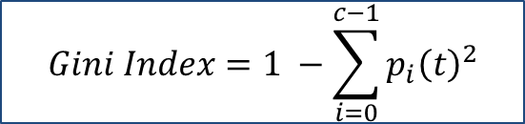
Impurity Measure for a Single Node
P(C₁) = 0/6 = 0 and P(C₂) = 6/6 = 1
Gini = 1 − (0)² − (1)² = 0
Entropy = −(0) log₂(0) − (1) log₂(1) = 0
Low entropy and GINI index preferred – low impurity
P(C₁) = 1/6 and P(C₂) = 5/6
Gini = 1 − (1/6)² − (5/6)² = 0.278
Entropy = −(1/6) log₂(1/6) − (5/6) log₂(5/6) = 0.650
P(C₁) = 2/6 P(C₂) = 4/6
Gini = 1 − (3/6)² − (3/6)² = 0.5
Entropy = −(3/6) log₂(3/6) − (3/6) log₂(3/6) = 1
$$Gini Index=1 −\sum_{i=0}^{c−1}{p_{i}{\left(t\right)}^{2}}$$
$$Entropy=−\sum_{i=0}^{c−1}{p_{i}\left(t\right)log_{2}p_{i}(t)}$$

Slide 31
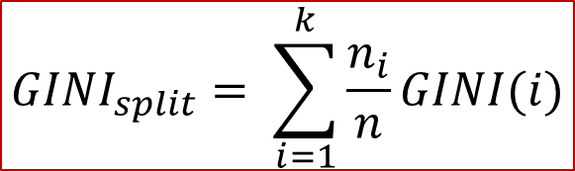
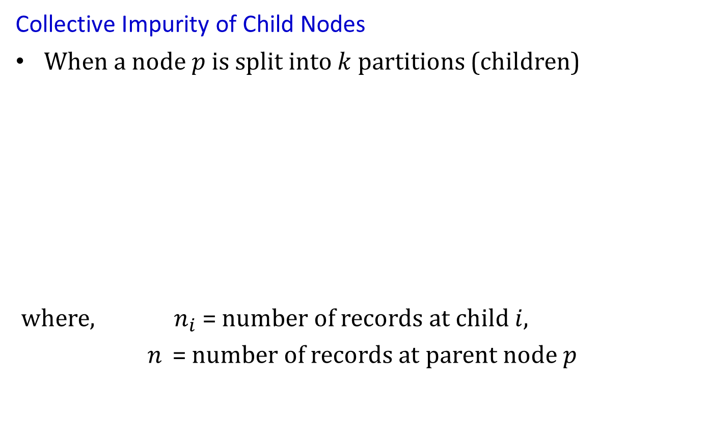

Computing impurity for a Collection of Nodes
Collective Impurity of Child Nodes
When a node $p$ is split into $k$ partitions (children)
where, $n_{i}$ = number of records at child $i$,
$n$ = number of records at parent node $p$
$$GINI_{split}= \sum_{i=1}^{k}{\frac{n_{i}}{n}GINI(i)}$$
$$Entropysplit= \sum_{i=1}^{k}{\frac{n_{i}}{n}Entropy(i)}$$

Slide 32
Finding the Best Split
Compute impurity measure (P) before
Compute impurity measure (M) after splitting
Compute impurity measure of each child node
M is the weighted impurity of child nodes
Choose the attribute test condition that produces the highest gain Gain = P – M
or equivalently, lowest impurity measure after splitting (M)
Information gain is the expected reduction in entropy caused by partitioning the examples on an attribute.
Maximizing the gain == minimizing the weighted average impurity measure of children nodes

Slide 33
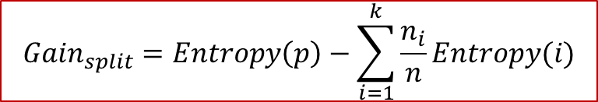
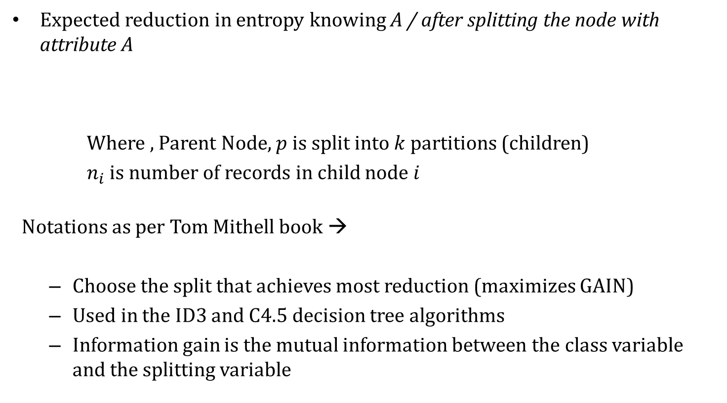
Computing Information Gain After Splitting
Expected reduction in entropy knowing A / after splitting the node with attribute A
Where , Parent Node, $p$ is split into $k$ partitions (children)
$n_{i}$ is number of records in child node $i$
Notations as per Tom Mithell book →
Choose the split that achieves most reduction (maximizes GAIN)
Used in the ID3 and C4.5 decision tree algorithms
Information gain is the mutual information between the class variable and the splitting variable
$$Gain_{split}=Entropy\left(p\right)−\sum_{i=1}^{k}{\frac{n_{i}}{n}Entropy(i)}$$

Slide 34
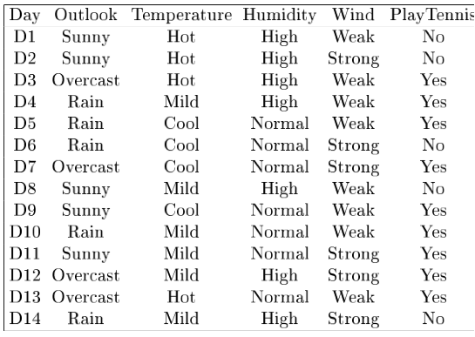
Example

Slide 35
Problem Setting
Set of possible instances X
each instance x in X is a feature vector
e.g., <Humidity=low, Wind=weak, Outlook=rain, Temp=hot>
Unknown target function f : X -> Y
Y is discrete valued
Set of function hypotheses H={ h | h : X->Y }
each hypothesis h is a decision tree
trees sorts x to leaf, which assigns y
Construct a DT -> Find the attribute that returns the highest information gain

Slide 36
Example
- information gain due to sorting the original 14 examples by the attribute Wind
Values(Wind) = {Weak, Strong}
S = [9+, 5−]
S_{Weak} = [6+, 2−]
S_{Strong} = [3+, 3−]
Entropy (S) ≡ – p₊ log₂ p₊ – p–log₂ p–
Entropy ([9+, 5–]) = – 9/14 log₂ (9/14) – 5/14 log₂ (5/14) = 0.94

Slide 37
Example
- information gain due to sorting the original 14 examples by the attribute Wind
Values(Wind) = {Weak, Strong}
S = [9+, 5−]
S_{Weak} = [6+, 2−]
S_{Strong} = [3+, 3−]
Entropy (S_{strong}[3+, 3–]) = 1
Entropy (S_{weak}[6+, 2–])
= – 6/8 log₂ (6/8) – 2/8 log₂ (2/8)
= 0.811
Gain(S, A_{Wind}) = Entropy(S) − 8/14 Entropy(S_{Weak}) − 6/14 Entropy(S_{Strong})
= 0.94 − 8/14 × 0.811 − 6/14 × 1.00
= 0.048

Slide 38
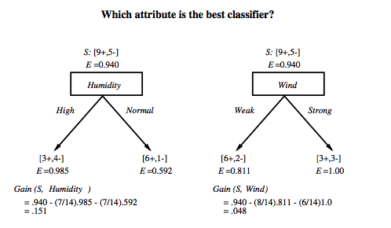
Which attribute is the best classifier?

Slide 39
First step: which attribute to test at the root?
Which attribute should be tested at the root?
Gain(S, Outlook) = 0.246
Gain(S, Humidity) = 0.151
Gain(S, Wind) = 0.048
Gain(S, Temperature) = 0.029
Outlook provides the best prediction for the target
Lets grow the tree:
add to the tree a successor for each possible value of Outlook
partition the training samples according to the value of Outlook

Slide 40
Example

Slide 41
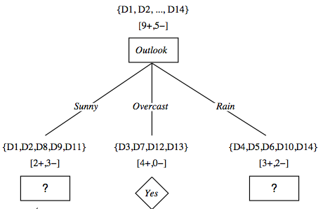
After first step

Slide 42
Outlook = Sunny branch and Attribute wind
S_{(outlook==sunny)} = [2+, 3−]
S_{(sunny && week)} = [1+, 2−]
S_{(sunny&&srong)} = [1+, 1−]
Entropy (S_{sunny}) ≡ – p₊ log₂ p₊ – p–log₂ p–
Entropy (S_{sunny}) =Entropy ([2+, 3–]) = – 2/5 log₂ (2/5) – 3/5 log₂ (3/5) = 0.97

Slide 43
Attribute wind
S_{(outlook==sunny)} = [2+, 3−]
S_{(sunny && week)} = [1+, 2−]
S_{(sunny&&srong)} = [1+, 1−]
E(S_{(week && sunny)} )= E([1+,2-]
= – 1/3 log₂ (1/3) – 2/3 log₂ (2/3)
= 0.918
E(S_{(sunny&&rong)}) = Entropy([1+,1-] = 1
Gain(S_{sunny}, A_{Wind}) = Entropy(S_{sunny}) − 3/5. Entropy(S_{sunny&&Weak}) − 2/5 Entropy(S_{sunny&&Strong})
= 0.97 − 3/5 x 0.918− 2/5 × 1 = 0.019

Slide 44
Second step
Working on Outlook=Sunny node:
Gain(S_{Sunny}, Humidity) = 0.970 − 3/5 × 0.0 − 2/5 × 0.0 = 0.970
Gain(S_{Sunny}, Wind) = 0.970 − 2/5 × 1.0 − 3/5 × 0.918 = 0 .019
Gain(S_{Sunny}, Temp.) = 0.970 − 2/5 × 0.0 − 2/5 × 1.0 − 1/5 × 0.0 = 0.570
Humidity provides the best prediction for the target
Lets grow the tree:
add to the tree a successor for each possible value of Humidity
partition the training samples according to the value of Humidity

Slide 45
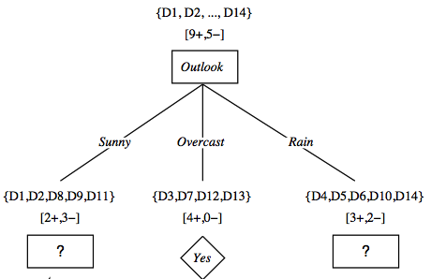
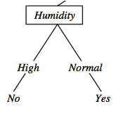
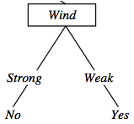
Second and third steps
{D1, D2, D8}
No
{D9, D11}
Yes
{D4, D5, D10}
Yes
{D6, D14}
No

Slide 46
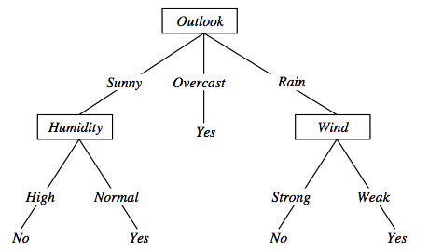
Decision Trees – Representation & Expressiveness
Decision trees represent a disjunction of conjunctions on constraints on the value of attributes:
(Outlook = Sunny ∧ Humidity = Normal) ∨
(Outlook = Overcast) ∨
(Outlook = Rain ∧ Wind = Weak)
〈Outlook=Sunny, Temp=Hot, Humidity=High, Wind=Strong〉 No

Slide 47
Problem with large number of partitions
Node impurity measures tend to prefer splits that result in large number of partitions, each being small but pure
Customer ID has highest information gain because entropy for all the children is zero
Consider the attribute Date in the PlayTennis example.
Date would have the highest information gain since it perfectly separates the training data.
Very good on the training, this tree would perform poorly in predicting unknown instances. Overfitting.

Slide 48
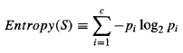
An alternative measure: Gain ratio
Recall… Given a collection S, the entropy of S relative to target variable is
SplitInformation measures the entropy of S with respect to the values of A. The more uniformly dispersed the data the higher it is.
where S₁ through S_{c}, are the c subsets of examples resulting from partitioning S by the c-valued attribute A
Splitlnfomation term discourages the selection of attributes with many uniformly distributed values such as Date

Slide 49
An alternative measure: Gain ratio
Let |S |=n, Date splits examples in n classes
SplitInformation(S, Date)= −[(1/n log₂ 1/n)+…+ (1/n log₂ 1/n)]= −log₂1/n =log₂n
Compare with A, which splits data in two even classes:
SplitInformation(S, A)= − [(1/2 log₂1/2)+ (1/2 log₂1/2) ]= − [− 1/2 −1/2]=1
The Gain Ratio measure is defined in terms of the earlier Gain measure, as well as this Splitlnfomation

Slide 50
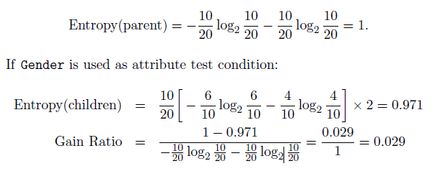
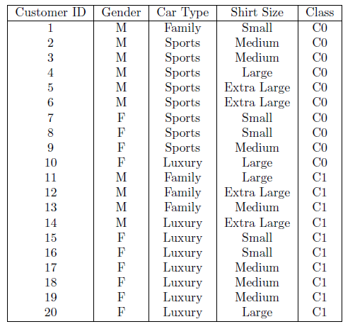
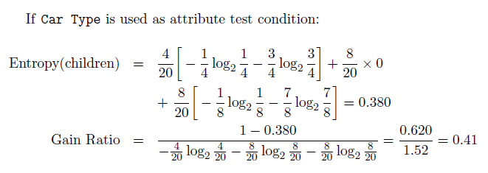
Limitation of Information Gain:
Ways to tackle

Slide 51
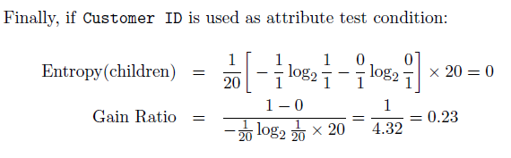
Limitation of Information Gain:
Ways to tackle
Inference : Thus, even though Customer ID has the highest information gain, its gain ratio is lower than Car Type since it produces a larger number of splits

Slide 52

ID3
Uses Hunt’s algorithm
Uses information gain as the measure to select the best attribute at each step in the growing tree
Does not have the ability to determine how many alternative decision trees are consistent with the available training data
Shorter trees are preferred over longer trees.
Trees that place high information gain attributes close to the root are preferred over those that do not - Inductive bias of ID3
Refer: Mitchell
BITS Pilani, Deemed to be University under Section 3 of UGC Act, 1956

Slide 53
ID3: algorithm
ID3(X, T, Attrs) X: training examples:
T: target attribute (e.g. PlayTennis),
Attrs: other attributes, initially all attributes
Create Root node
If all X's are +, return Root with class +
If all X's are –, return Root with class –
If Attrs is empty return Root with class most common value of T in X
else
A ← best attribute; decision attribute for Root ← A
For each possible value v_{i} of A:
- add a new branch below Root, for test A = v_{i}
- X_{i} ← subset of X with A = v_{i}
- If X_{i} is empty then add a new leaf with class the most common value of T in X
else add the subtree generated by ID3(X_{i}, T, Attrs − {A})
return Root

Slide 54
Prefer shorter hypotheses: Occam's razor
Why prefer shorter hypotheses?
Arguments in favor:
There are fewer short hypotheses than long ones
If a short hypothesis fits data unlikely to be a coincidence
Elegance and aesthetics
Arguments against:
Not every short hypothesis is a reasonable one.
Occam's razor says that when presented with competing hypotheses that make the same predictions, one should select the solution which is simple"

Slide 55
Dealing with continuous-valued attributes
If features are continuous, internal nodes can test the value of a feature against a threshold

Slide 56
Dealing with continuous-valued attributes
Given a continuous-valued attribute A, dynamically create a new attribute Ac
Ac = True if A < c, False otherwise
How to determine threshold value c ?
Example. Temperature in the PlayTennis example
Sort the examples according to Temperature
Temperature 40 48 | 60 72 80 | 90
PlayTennis No No 54 Yes Yes Yes 85 No
Determine candidate thresholds by averaging consecutive values where there is a change in classification: (48+60)/2=54 and (80+90)/2=85

Slide 57
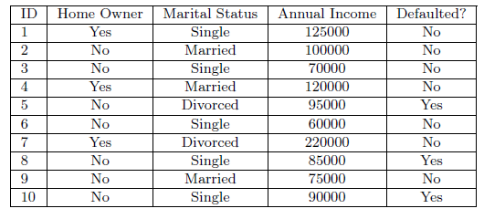
Binary Splitting of continuous Attributes-Gini Index

Slide 58
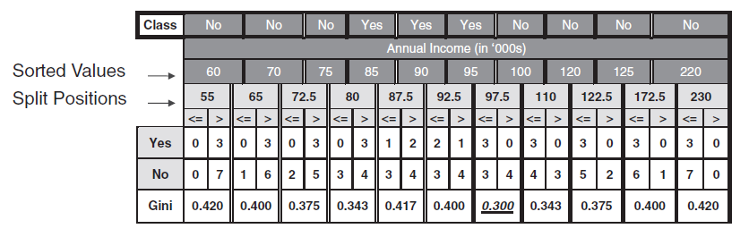

Binary Splitting of continuous Attributes-Gini Index
$$Gini Index=1 −\sum_{i=0}^{c−1}{p_{i}{\left(t\right)}^{2}}$$
For efficient computation: for each attribute,
Sort the attribute on values
Linearly scan these values, each time updating the count matrix and computing gini index
Choose the split position that has the least Gini index (the most purer subset)
Splitpoint – 97.5 in below example

Slide 59
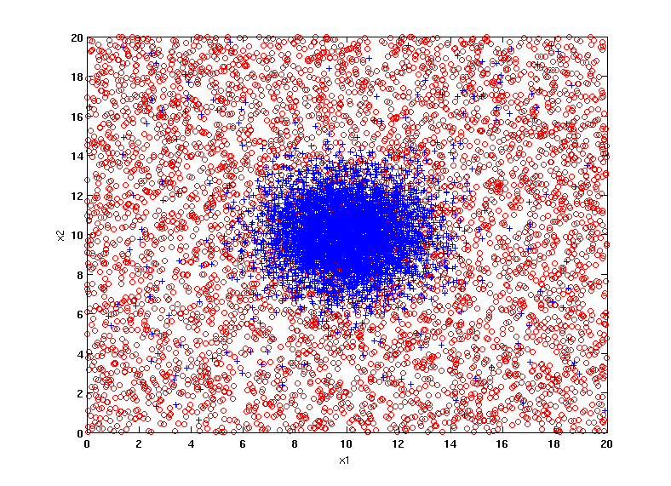
Example Data Set
Two class problem:
+ : 5200 instances
5000 instances generated from a Gaussian centered at (10,10)
200 noisy instances added
o : 5200 instances
Generated from a uniform distribution
10 % of the data used for training and 90% of the data used for testing
BITS Pilani, Deemed to be University under Section 3 of UGC Act, 1956

Slide 60
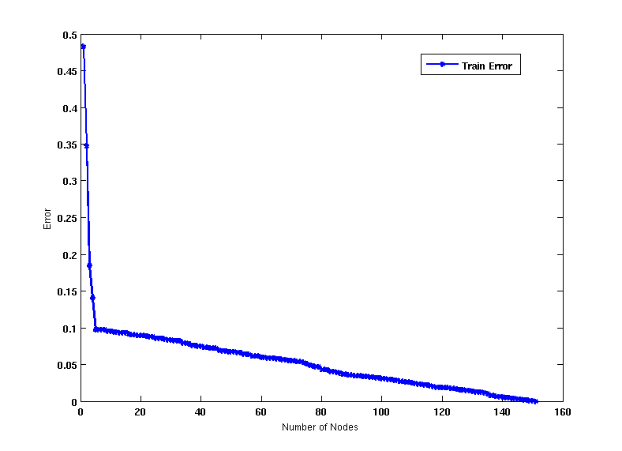
Increasing number of nodes in Decision Trees
BITS Pilani, Deemed to be University under Section 3 of UGC Act, 1956

Slide 61
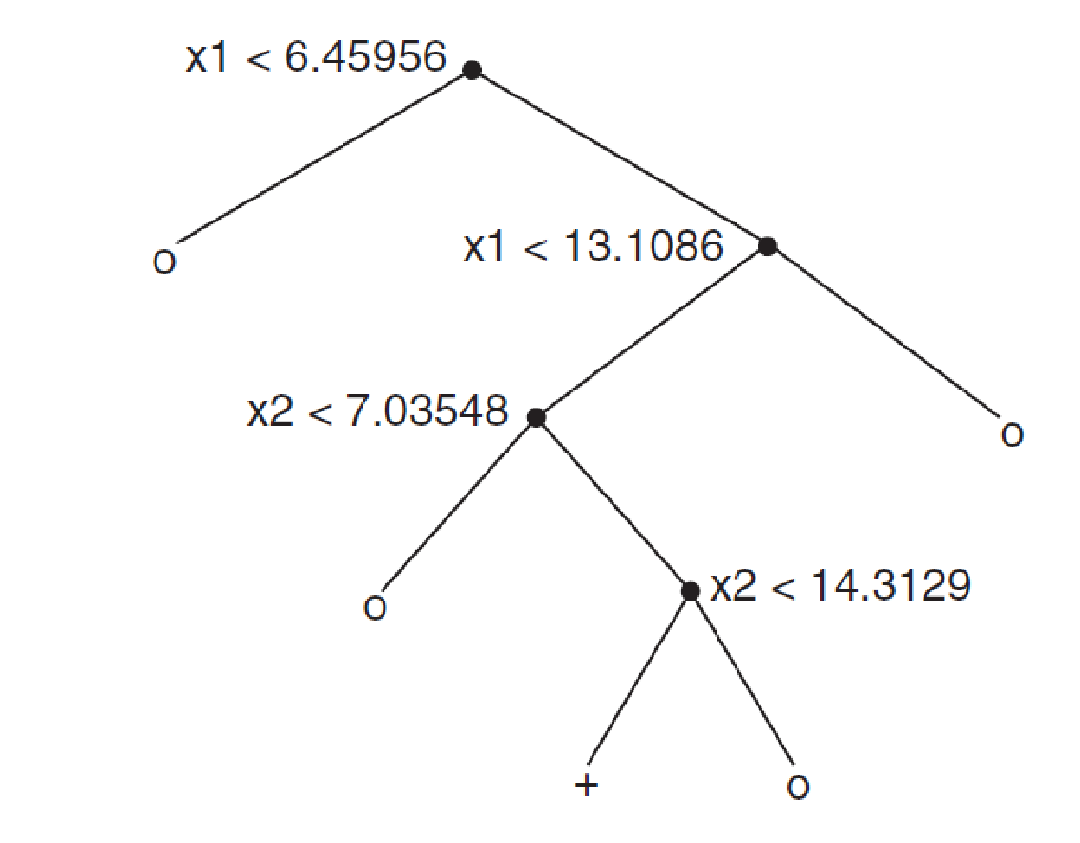
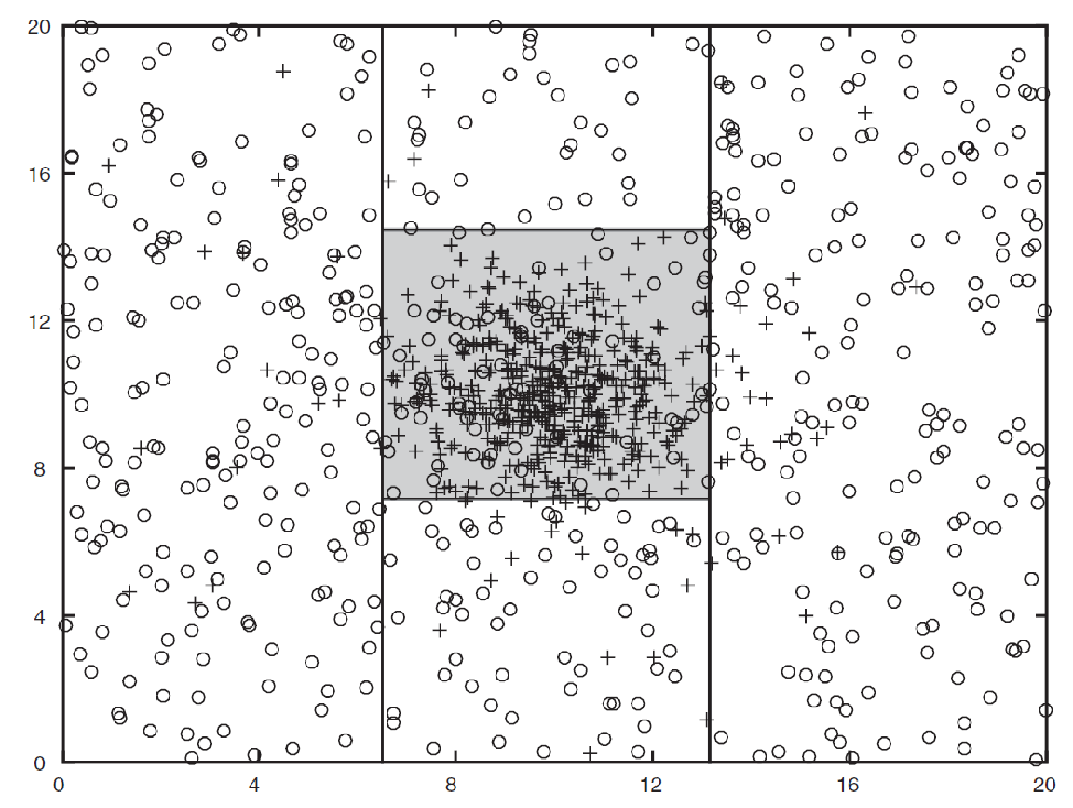
Decision Tree with 4 nodes
Decision Tree
Decision boundaries on Training data
BITS Pilani, Deemed to be University under Section 3 of UGC Act, 1956

Slide 62
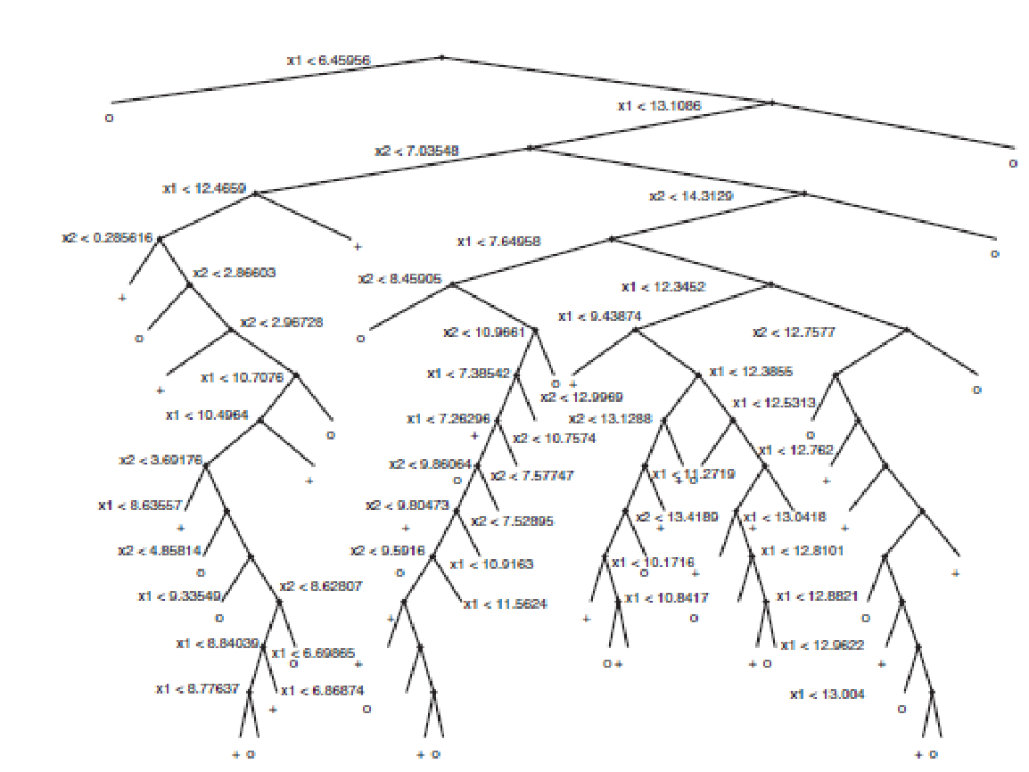
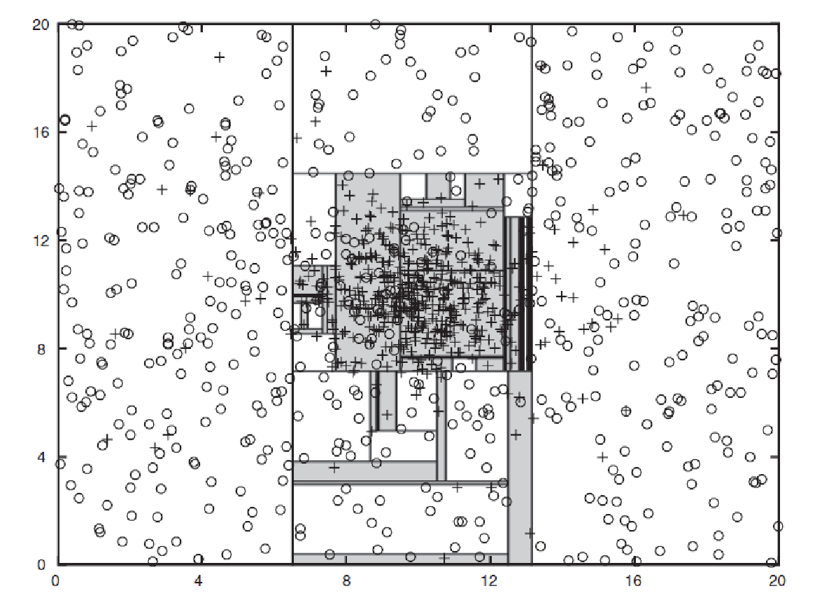
Decision Tree with 50 nodes
Decision Tree
Decision Tree
Decision boundaries on Training data
BITS Pilani, Deemed to be University under Section 3 of UGC Act, 1956

Slide 63
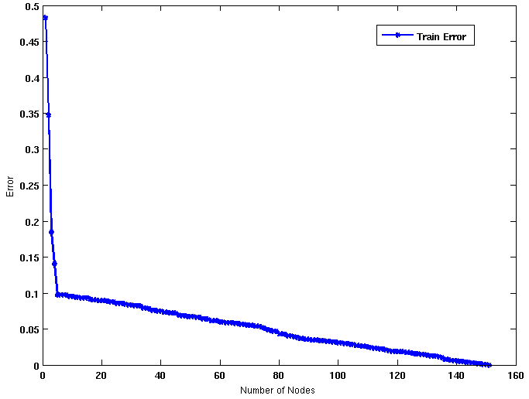
Which tree is better?
Decision Tree with 4 nodes
Which tree is better ?
Decision Tree with 50 nodes
BITS Pilani, Deemed to be University under Section 3 of UGC Act, 1956

Slide 64
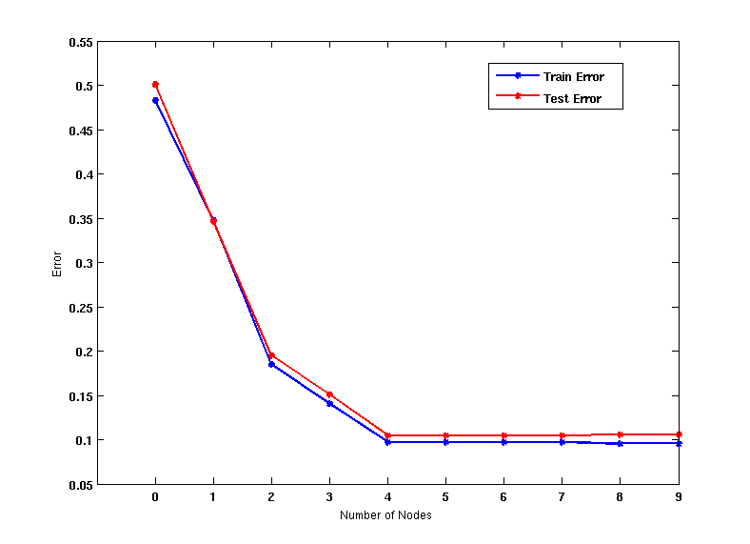
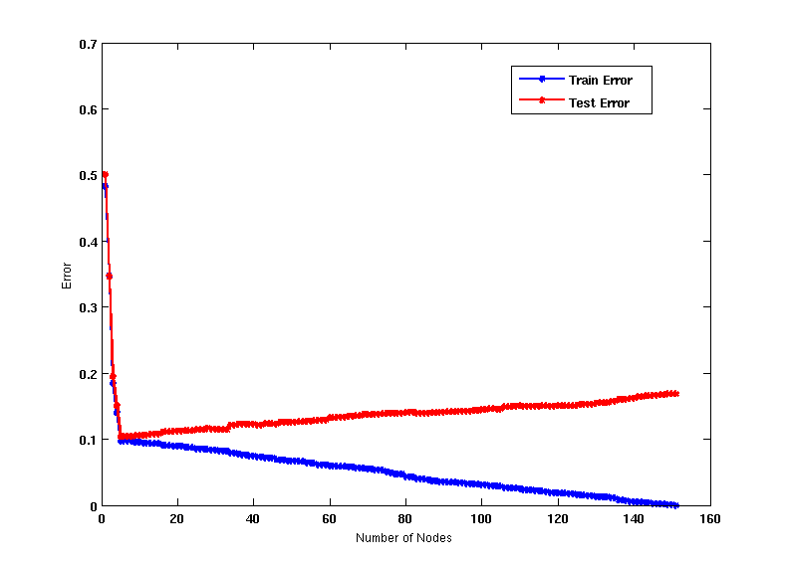
Model Overfitting
Underfitting: when model is too simple, both training and test errors are large
Overfitting: when model is too complex, training error is small but test error is large
BITS Pilani, Deemed to be University under Section 3 of UGC Act, 1956

Slide 65
Issues in Decision Tree Learning - Handling Overfitting
Two approaches
Pre pruning (early stopping rule)
Stop growing the tree earlier, before it reaches the point where it perfectly classifies the training data
Difficult to estimate when to stop growing the tree
Post-pruning
Allow the tree to overfit the data, and then post-prune the tree
BITS Pilani, Deemed to be University under Section 3 of UGC Act, 1956

Slide 66
Model Selection for Decision Trees
Pre-Pruning (Early Stopping Rule)
Stop the algorithm before it becomes a fully-grown tree
Typical stopping conditions for a node:
Stop if all instances belong to the same class
Stop if all the attribute values are the same
More restrictive conditions:
Stop if number of instances is less than some user-specified threshold
Stop if expanding the current node does not improve impurity measures (e.g., Gini or information gain).
Stop if estimated generalization error falls below certain threshold
BITS Pilani, Deemed to be University under Section 3 of UGC Act, 1956

Slide 67
Pre-pruning
Train set
Predict if the object being manufactured is likely to be “Reject”ed or “Allow”ed to be packed during the automated product inspection based on object features like : Shape, colour, size
Assume this the trained model which is an over fit. Let try to experiment on Pre-pruning & Post-pruning technique.
Use validation set/test set for this experiments
Shape | Colour | Size | Action
Round | Green | Small | Reject
Square | Black | Big | Allow
Square | Brown | Big | Allow
Round | Brown | Small | Reject
Square | Green | Big | Allow
Square | Brown | Small | Reject
Oval | Green | Big | Reject
Oval | Brown | Small | Allow
Oval | Green | Small | Reject
Assumed over fit model
Shape
Round
Square
Oval
Test set
Size
Colour
Big
Small
Green
Shape | Colour | Size | Action
Oval | Black | Small | Reject
Round | Brown | Big | Allow
Square | Brown | Big | Allow
Oval | Green | Small | Allow
Brown
Allow
Reject
Reject
Allow
Colour
Green
Brown
Size
Size
Small
Reject
Reject

Slide 68
Pre-Pruning
Use maximum gain to stop the tree growth as threshold for pre-pruning
Shape | Colour | Size | Action
Round | Green | Small | Reject
Square | Black | Big | Allow
Square | Brown | Big | Allow
Round | Brown | Small | Reject
Square | Green | Big | Allow
Square | Brown | Small | Reject
Oval | Green | Big | Reject
Oval | Brown | Small | Allow
Oval | Green | Small | Reject
Prune if threshold Gain <=0.85
Shape
Round
Square
Oval
Reject
Colour | Size | Action
Black | Big | Allow
Brown | Big | Allow
Green | Big | Allow
Brown | Small | Reject
Colour | Size | Action
Green | Big | Reject
Brown | Small | Allow
Green | Small | Reject
Gain =0.8113 Gain =0.9182
Shape | Colour | Size | Action
Oval | Black | Small | Reject
Round | Brown | Big | Allow
Square | Brown | Big | Allow
Oval | Green | Small | Allow

Slide 69
Pre-Pruning
Shape | Colour | Size | Action
Round | Green | Small | Reject
Square | Black | Big | Allow
Square | Brown | Big | Allow
Round | Brown | Small | Reject
Square | Green | Big | Allow
Square | Brown | Small | Reject
Oval | Green | Big | Reject
Oval | Brown | Small | Allow
Oval | Green | Small | Reject
Prune if threshold Gain <=0.85
Shape
Round
Square
Oval
Reject
Colour | Size | Action
Black | Big | Allow
Brown | Big | Allow
Green | Big | Allow
Brown | Small | Reject
Colour
Green
Brown
Reject
Allow
Use majority voting to label the nodes post pruning
Shape | Colour | Size | Action
Oval | Black | Small | Reject
Round | Brown | Big | Allow
Square | Brown | Big | Allow
Oval | Green | Small | Allow

Slide 70
Pre-Pruning
Shape | Colour | Size | Action
Round | Green | Small | Reject
Square | Black | Big | Allow
Square | Brown | Big | Allow
Round | Brown | Small | Reject
Square | Green | Big | Allow
Square | Brown | Small | Reject
Oval | Green | Big | Reject
Oval | Brown | Small | Allow
Oval | Green | Small | Reject
Prune if threshold Gain <=0.85
Shape
Round
Square
Oval
Reject
Allow
Colour
Green
Brown
Reject
Allow
Shape | Colour | Size | Action
Oval | Black | Small | Reject
Round | Brown | Big | Allow
Square | Brown | Big | Allow
Oval | Green | Small | Allow

Slide 71
Post-pruning
Idea :
1. Post construction, scan the tree bottom-up
2. At every decision node
Retain the attribute node & evaluate it against the prune set (validation set)
Remove the attribute node & reevaluate it with the same prune set
If there is a reduction in error, prune the node else retain the node
3. Repeat this in other branches of the tree
BITS Pilani, Deemed to be University under Section 3 of UGC Act, 1956

Slide 72
Post Pruning
Shape | Colour | Size | Action
Round | Green | Small | Reject
Square | Black | Big | Allow
Square | Brown | Big | Allow
Round | Brown | Small | Reject
Square | Green | Big | Allow
Square | Brown | Small | Reject
Oval | Green | Big | Reject
Oval | Brown | Small | Allow
Oval | Green | Small | Reject
Shape
Round
Square
Oval
Reject
Size
Colour
Big
Small
Green
Brown/others
Allow
Reject
Reject
Allow
Shape | Colour | Size | Action
Oval | Black | Small | Reject
Round | Brown | Big | Allow
Square | Brown | Big | Allow
Oval | Green | Small | Allow
Error rate is the percentage of tuples misclassified
Prune set is used to estimate the cost

Slide 73
Post Pruning
Shape | Colour | Size | Action
Round | Green | Small | Reject
Square | Black | Big | Allow
Square | Brown | Big | Allow
Round | Brown | Small | Reject
Square | Green | Big | Allow
Square | Brown | Small | Reject
Oval | Green | Big | Reject
Oval | Brown | Small | Allow
Oval | Green | Small | Reject
Shape
Round
Square
Oval
Reject
Size
Colour
Big
Small
Green
Brown/others
Allow
Reject
Reject
Allow
After test prune on “Size” and “Color” attributes, its observed that “Colour” is best pruned to get better accuracy!
Prune Size &Predict | Prune Colour & Predict | Above Tree’s Prediction | Shape | Colour | Size | Action
Allow | Reject | Allow | Oval | Black | Small | Reject
Reject | Reject | Reject | Round | Brown | Big | Allow
Allow | Allow | Allow | Square | Brown | Big | Allow
Reject | Reject | Reject | Oval | Green | Small | Allow

Slide 74
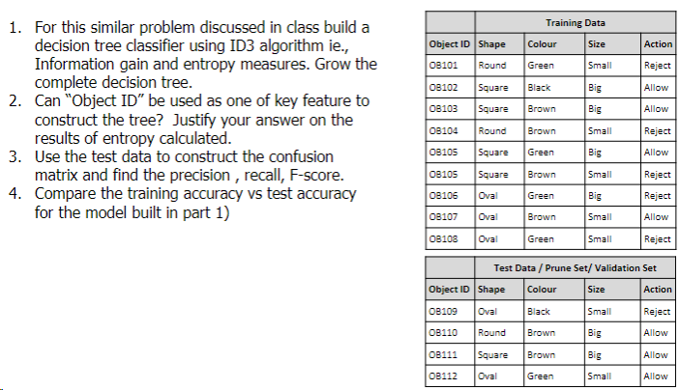
Practice Exercises (for Students)

Slide 75
Revision for Mid Term Examination
Review of uploaded Question Paper
Important Note to students:
Check the canvas announcement for any exam related details/ question pattern/ sample questions.
Handout mapped prescribed book sections, class discussions , practice exercises shared in all the slides must be revised for the exam preparation
Since the mid term exam is CLOSED BOOK mode, no reference material is allowed and hence formula needs to be learnt by the students
Queries may not be answered once the exam starts.
Kindly Plan ahead to get your preparation queries resolved before the EXAM START DATE of your batch.

Slide 76
References
Chapter 3 - Tom Mitchell
Chapter 4 - Introduction to Data Mining by Pang-Ning Tan, Michael Steinbach, Vipin Kumar
Good References
Decision Tree
https://www.youtube.com/watch?v=eKD5gxPPeY0&list=PLBv09BD7ez_4temBw7vLA19p3tdQH6FYO&index=1
Overfitting
https://www.youtube.com/watch?time_continue=1&v=t56Nid85Thg
https://www.youtube.com/watch?v=y6SpA2Wuyt8

Slide 78
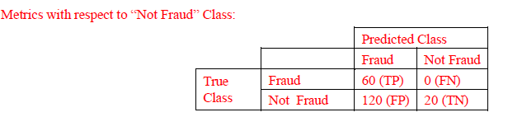

Slide 79
